Slide 1
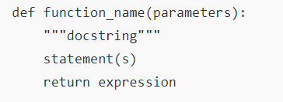
INTRODUCTION TO FUNCTIONS
A function is a block of code which only runs when it is called.
You can pass data, known as parameters, into a function.
A function can return data as a result.
SYNTAX

Slide 2
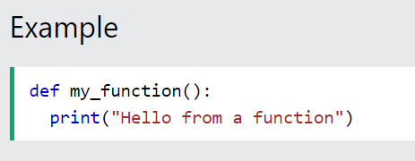
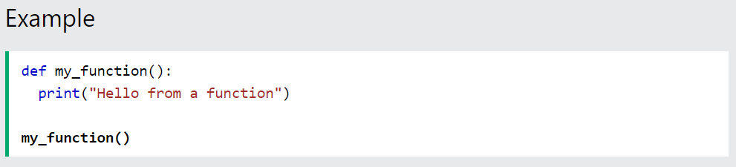
Creating a Function
In Python a function is defined using the def keyword:
Calling a Function
To call a function, use the function name followed by parenthesis:

Slide 3
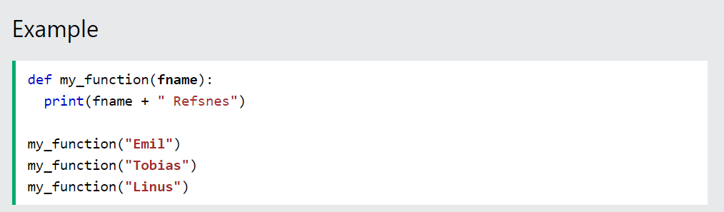
Arguments
Information can be passed into functions as arguments.
Arguments are specified after the function name, inside the parentheses. You can add as many arguments as you want, just separate them with a comma.
The following example has a function with one argument (fname). When the function is called, we pass along a first name, which is used inside the function to print the full name:

Slide 4
Parameters or Arguments?
The terms parameter and argument can be used for the same thing: information that are passed into a function.
From a function's perspective:
A parameter is the variable listed inside the parentheses in the function definition.
An argument is the value that is sent to the function when it is called.

Slide 5
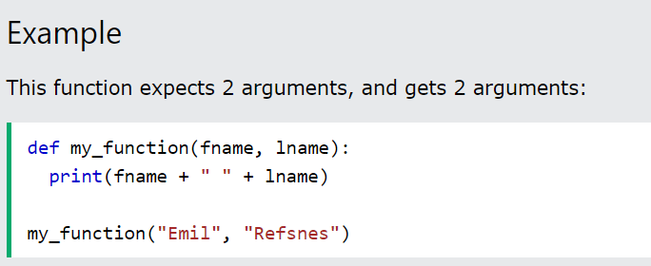
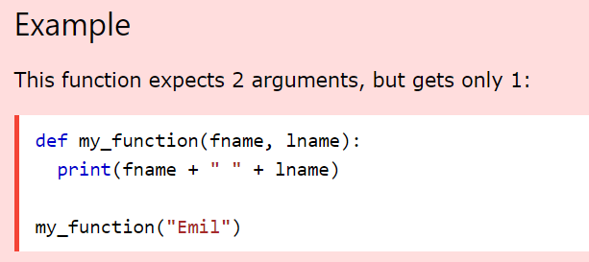
Number of Arguments
By default, a function must be called with the correct number of arguments. Meaning that if your function expects 2 arguments, you have to call the function with 2 arguments, not more, and not less.
If you try to call the function with 1 or 3 arguments, you will get an error:

Slide 6
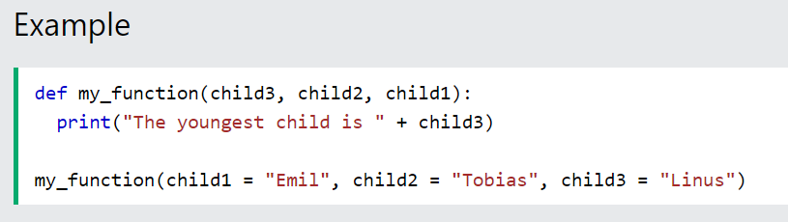
Keyword Arguments
You can also send arguments with the key = value syntax.
This way the order of the arguments does not matter.
The phrase Keyword Arguments are often shortened to kwargs in Python documentations.

Slide 7
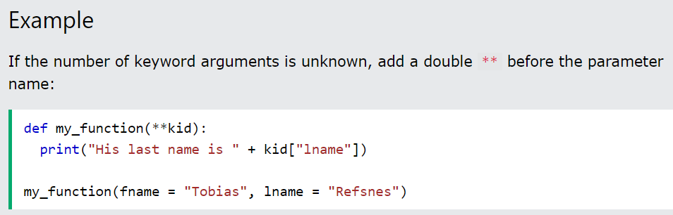
Arbitrary Keyword Arguments, **kwargs
If you do not know how many keyword arguments that will be passed into your function, add two asterisk: ** before the parameter name in the function definition.
This way the function will receive a dictionary of arguments, and can access the items accordingly:
If we call the function without argument, it uses the default value

Slide 8
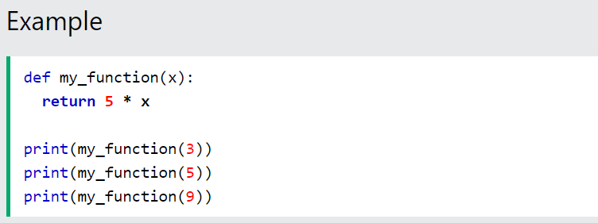

Passing a List as an Argument
You can send any data types of argument to a function (string, number, list, dictionary etc.), and it will be treated as the same data type inside the function.
Return Values
To let a function return a value, use the return statement:

Slide 9
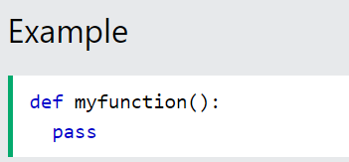
The pass Statement
function definitions cannot be empty, but if you for some reason have a function definition with no content, put in the pass statement to avoid getting an error.

Slide 10
Global variables are those which are not defined inside any function and have a global scope whereas local variables are those which are defined inside a function and its scope is limited to that function only. In other words, we can say that local variables are accessible only inside the function in which it was initialized whereas the global variables are accessible throughout the program and inside every function.
Local Variables
Local variables are those which are initialized inside a function and belongs only to that particular function. It cannot be accessed anywhere outside the function. Let’s see how to create a local variable.

Slide 11
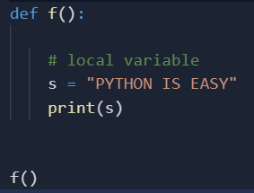
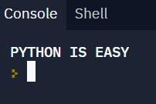
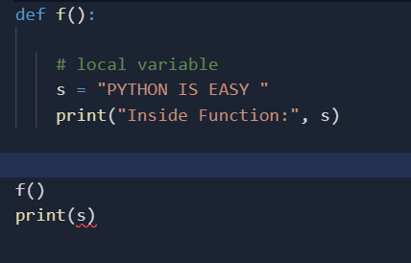
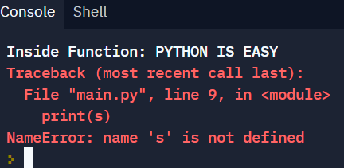
Local Variables
Local variables are those which are initialized inside a function and belongs only to that particular function. It cannot be accessed anywhere outside the function. Let’s see how to create a local variable.
If we will try to use this local variable outside the function then let’s see what will happen.

Slide 12
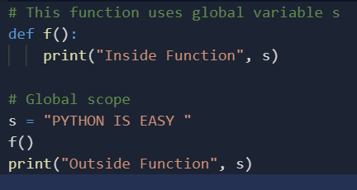

Global Variables
The global variables are those which are defined outside any function and which are accessible throughout the program i.e. inside and outside of every function Let’s see how to create a global variable.

Slide 13
Note: As there are no locals, the value from the globals will be used.
Now, what if there is a variable with the same name initialized inside a function as well as globally. Now the question arises, will the local variable will have some effect on the global variable or vice versa, and what will happen if we change the value of variable inside of the function f()? Will it affect the globals as well? We test it in the following piece of code:
Python3
# This function has a variable with # name same as s. def f(): s = "Me too." print(s) # Global scope s = “PYTHON IS EASY " f() print(s)
Output:
Me too. PYTHON IS EASY .
If a variable with the same name is defined inside the scope of function as well then it will print the value given inside the function only and not the global value.

Slide 14

Python Scope
❮
A variable is only available from inside the region it is created. This is called scope.
Local Scope
A variable created inside a function belongs to the local scope of that function, and can only be used inside that function.
Example
A variable created inside a function is available inside that function:
def myfunc(): x = 300 print(x) myfunc()

Slide 15
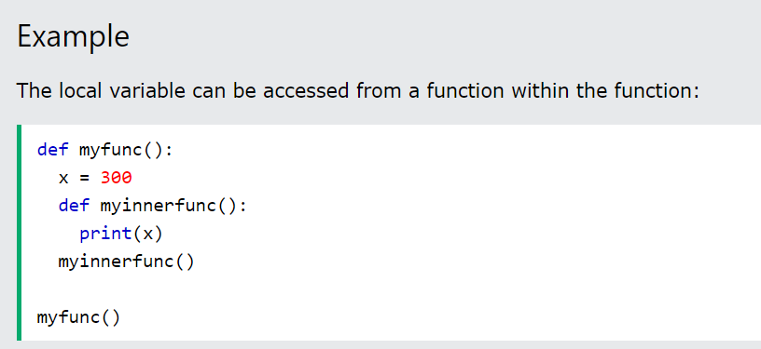
Function Inside Function
As explained in the example above, the variable x is not available outside the function, but it is available for any function inside the function:
Global Scope
A variable created in the main body of the Python code is a global variable and belongs to the global scope.
Global variables are available from within any scope, global and local.

Slide 16
Naming Variables
If you operate with the same variable name inside and outside of a function, Python will treat them as two separate variables, one available in the global scope (outside the function) and one available in the local scope (inside the function):
Global Keyword
If you need to create a global variable, but are stuck in the local scope, you can use the global keyword.
The global keyword makes the variable global.
Also, use the global keyword if you want to make a change to a global variable inside a function.

Slide 17
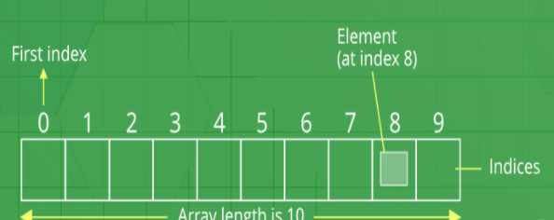
ARRAYS IN PYTHON
Python Arrays
An array is a collection of items stored at contiguous memory locations. The idea is to store multiple items of the same type together. This makes it easier to calculate the position of each element by simply adding an offset to a base value, i.e., the memory location of the first element of the array (generally denoted by the name of the array).

Slide 18
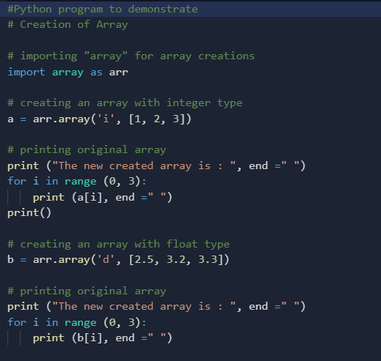
Creating a Array
Array in Python can be created by importing array module. array(data_type, value_list) is used to create an array with data type and value list specified in its arguments.

Slide 19
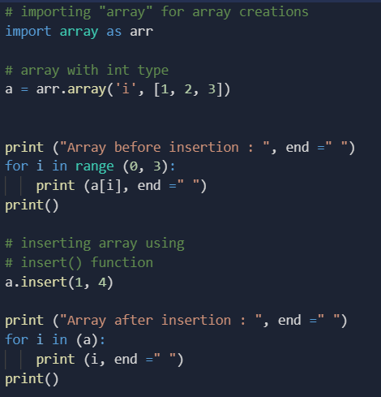
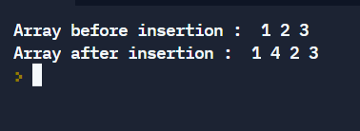
Adding Elements to a Array
Elements can be added to the Array by using built-in insert() function. Insert is used to insert one or more data elements into an array. Based on the requirement, a new element can be added at the beginning, end, or any given index of array. append() is also used to add the value mentioned in its arguments at the end of the array.

Slide 20
Accessing elements from the Array
In order to access the array items refer to the index number. Use the index operator [ ] to access an item in a array. The index must be an integer.
Removing Elements from the Array
Elements can be removed from the array by using built-in remove() function but an Error arises if element doesn’t exist in the set. Remove() method only removes one element at a time, to remove range of elements, iterator is used. pop() function can also be used to remove and return an element from the array, but by default it removes only the last element of the array, to remove element from a specific position of the array, index of the element is passed as an argument to the pop() method. Note – Remove method in List will only remove the first occurrence of the searched element.

Slide 21
Slicing of a Array
In Python array, there are multiple ways to print the whole array with all the elements, but to print a specific range of elements from the array, we use Slice operation. Slice operation is performed on array with the use of colon(:). To print elements from beginning to a range use [:Index], to print elements from end use [:-Index], to print elements from specific Index till the end use [Index:], to print elements within a range, use [Start Index:End Index] and to print whole List with the use of slicing operation, use [:]. Further, to print whole array in reverse order, use [::-1].
Searching element in a Array
In order to search an element in the array we use a python in-built index() method. This function returns the index of the first occurrence of value mentioned in arguments.

Slide 22
Python lambda
In Python, anonymous function means that a function is without a name. As we already know that def keyword is used to define the normal functions and the lambda keyword is used to create anonymous functions. It has the following syntax:
lambda arguments : expression
This function can have any number of arguments but only one expression, which is evaluated and returned.
One is free to use lambda functions wherever function objects are required.
You need to keep in your knowledge that lambda functions are syntactically restricted to a single expression.
It has various uses in particular fields of programming besides other types of expressions in functions.

Slide 23
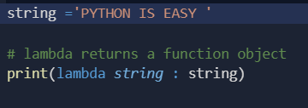

In this above example, the lambda is not being called by the print function but simply returning the function object and the memory location where it is stored. So, to make the print to print the string first we need to call the lambda so that the string will get pass the print.

Slide 24

Example #2: Difference between lambda and normal function call
def cube(y):
return y*y*y;
g = lambda x: x*x*x
print(g(7))
print(cube(5))

Slide 25
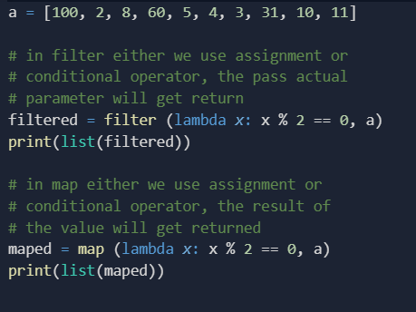
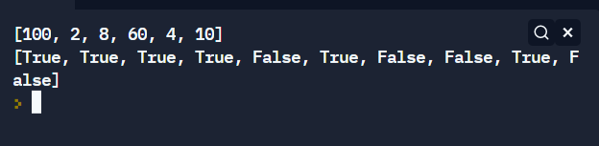
Example #3: filter() and map(
OUTPUT :

